Slide 1
Cash Flow Management Top Tips

Slide 2
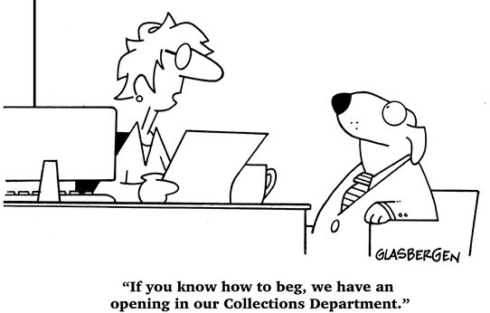


Let’s not overcomplicate it…
INCOME: make sure you know what customers owe you and get that money in as quickly as possible.
EXPENDITURE: keep up with what you owe others (landlords, suppliers, employees, etc.) and make sure that they are paid on time. Don’t incur more costs than you can afford to pay.
IDENTIFY: know when there are shortfalls and take the necessary steps to fix them as quickly as possible.

Slide 3

How do you make this happen?
BUSINESS
Don’t let customers delay payments.
Negotiate your bills-in payment terms to extend as long as possible.
Use a cash flow management tool or accounting software.
Incentivise customers.
Build reserves.
Notes:
Don’t let customers delay payments. If you are owed money, expect to be paid, and be persistent about it. This persistence should be underpinned by: prompt invoicing, clear payment terms, providing due dates and establishing late fees. The longest you’ll want your payment date is 30 days post issuing the invoice – don’t go any longer than this.
Negotiate your bills-in payment terms to extend as long as possible. You may want your customers to pay you as fast as possible, but the opposite is also true, obviously you want a reputation for paying your bills on time. But that does not mean that you cannot negotiate favourable terms. Try to get 60 or 90-day if possible. This can give you much greater flexibility and will most likely help you in managing any cash flow issues you might have.
Use a cash flow management tool or accounting software. Electronically managing your income and expenditure will make your life a lot easier. It’ll save you time and money in the long run and really set you up for growth. Here are some of the typical ones people use: https://www.xero.com/uk/ / https://www.crunch.co.uk/ / https://stripe.com/en-gb/billing / https://quickbooks.intuit.com/uk/
Incentivise customers. Give customers incentives to pay quickly e.g. a discount for immediate payment.
Build reserves. “Reserves” are just another name for “cash in the bank”. Typical practice is to have 3 to 6 months’ worth of operating expenses in reserves. To give an example, if it costs you £2000 a month to run your business, you should have £6000 to £12000 in the bank. This practice is important as it helps you cover major cash flow challenges you may face e.g. loss of a key customer, unexpected bill, funding growth……a pandemic!
NOTE: All of this needs to be underpinned by having the correct pricing structure and strategy in place

